Slide 1
League of Legends Champion
Recommender
Springboard Data Science Career Track
Chris Gardner
April 11th 2018

Slide 2
Problem and Client
Our client is Riot Games the developer of League of Legends. Riot Games is having issues retaining users.
The problem that Riot Games has identified is that users (players) are tired of repetitive gameplay cause by playing the same characters (champions) over and over. Our solution to this is a recommender system to increase each user’s champion diversity.

Slide 3
Dataset Explanation
Recommender systems need user (player) and item (champion) data to make predictions. The metric we will use is called Champion Mastery.
“The mastery system is designed to recognize a player's respective investment in a champion and uses skill-based progression to measure advancement... Points are based on your performance, your team’s performance, the length of the game, win vs. loss and a few other factors.” - Riot Games
Using the assumption that enjoyment relates to proficiency, the champion mastery system becomes a metric of preference.

Slide 4
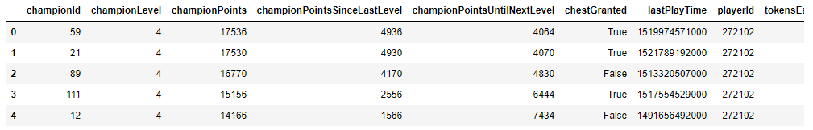
Data Scraping: Mastery Data
The League of Legends API provides easy access to the champion mastery information by user. The data simply needs to be transformed into the right form.
Above is a sample output for champion mastery data. We are most interested in champion points since its a more useful metric than champion level for making predictions.

Slide 5
Data Scraping: Gathering Users
Since the API does not give us a list of users we designed a simple protocol to gather users.
Request a user’s most recent 20 games.
Gather a list of users for each of those games.
Repeat steps 1-2 until enough users are gathered.
Using my personal account as a seed the method above was used to gather 10,000 users.

Slide 6
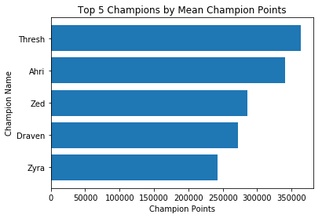
Data Exploration: Most Champion Points
Champion (Id) | Total Summed Champion Points
Thresh (412) | 289064356
Yasuo (157) | 265167147
Vayne (67) | 263557123
Ezreal (81) | 228536943
Jhin (202) | 227652027
The top champions by total and mean champion points across all users can be used to inform us which champions are popular. This information can be used later to optimize the recommender incase it leans too much towards the popular items.

Slide 7
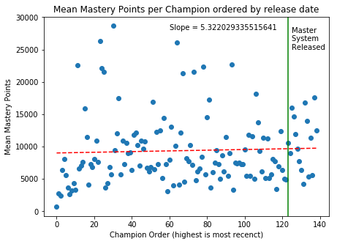
Data Exploration: Champion Release Order
We want to know how the release date of champions affects their champion mastery points. This is important since the Mastery system is relatively new compared to League of Legends.
Newer Champions a favored more so we should take care to ensure that older champions do not get stuck in the long tail.

Slide 8
Data Exploration:
Standard deviation is a very insightful statistic. A high std dev implies that many players either prefer a champion a lot or don’t play it at all. While low std dev Implies consistent mastery across the board. Kai’sa is interesting for its low std dev. This makes sense if you consider she was released a month before this project. All users have lower mastery.
Champion (Id) | Standard Deviation
Thresh (412) | 969689
Ahri (103) | 924257
Zed (238) | 767840
Draven (119) | 740387
Aatrox (266) | 661385
... | ...
Ornn (516) | 60886
Kai’Sa (145) | 13676

Slide 9
Building the Recommender: Model Type
Model Type: Collaborative filtering
Typically Collaborative filtering models have issues with cold-start (not a lot of users), sparsity and new items. The champion mastery system is able to mitigate two of these issues.
Our dataset avoids cold start with 67million active users monthly in 2014. (Even if this project will only use a subset of 10k users)
Sparsity is not as much of an issue with so many users and 140 items. It should be easy to find other users who play the same champions.
We choose to use a collaborative filtering approach because of these benefits. The champion mastery system also lends itself to a collaborative approach.

Slide 10
Building the Recommender: Normalization
Normalization is extremely important to avoid datasets being dominated too harshly by popularity or highly skilled users.
We are primarily interested in row-based (user-based) normalization to prevent a overall high skill user or low skill users from skewing data.
We will use a Standard Scaler to standardize to normally distributed data.
While these two points are our objectives we will be testing other normalization methods for comparison.

Slide 11
Evaluating the Recommender: Standard Scaler
Very few combinations of algorithms and normalizations perform better than the baseline. SVD, and K-nn with Cosine/Pearson are the standouts.
It is concerning that most of the recommenders have the same RMSE score of 1.4142.
Model | Column Scaled | Row Scaled | Row -> Column | Column -> Row
Base | 1.4142 | 1.4142 | 1.4142 | 1.4142
Slope One | 1.4143 | 1.4142 | 1.4142 | 1.4142
NMF | 1.4195 | 1.4246 | 1.4259 | 1.4272
SVD | 1.4127 | 1.4100 | 1.4142 | 1.4132
Item-item Cosine K-nn | 1.4125 | 1.4139 | 1.4142 | 1.4140
Item-item MSD K-nn | 1.4156 | 1.4142 | 1.4142 | 1.4142
Item-item Pearson K-nn | 1.4126 | 1.4127 | 1.4145 | 1.4138

Slide 12
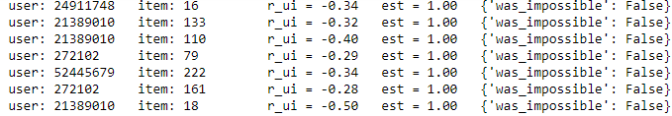
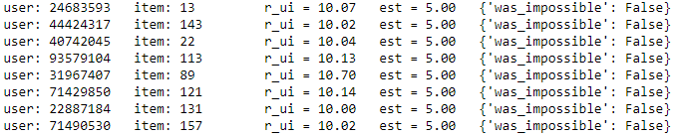
Evaluating the Recommender: Prediction Limitations
We decided to examine the actual estimations of the standard scaled data to understand what the issue of similar RMSE scores is.
Here it becomes obvious there is a minimum prediction score at 1 and a maximum at 5. After determining there was a minimum a min-max scaler was used to find the maximum prediction score by moving the data to a range between 10-20.

Slide 13
Evaluating the Recommender: Min-max Scaler
Model | Row Scaled | Column Scaled
Base | 0.5431 | 0.1295
Slope One | 0.5462 | 0.1319
NMF | 0.5259 | 0.1354
SVD | 0.5109 | 0.1296
Item-item Cosine K-nn | 0.5714 | 0.1341
Item-item MSD K-nn | 0.5710 | 0.1341
Item-item Pearson K-nn | 0.5203 | 0.1420
Based on the min/max prediction scores we re-evaluated using a min-max scaler on the range 1-5. This improves the RMSE scores overall and shows that SVD on row scaled data is again the highest performing algorithm. The min-max scaler successfully help distinguish the algorithms more effectively by avoiding prediction limitations.

Slide 14
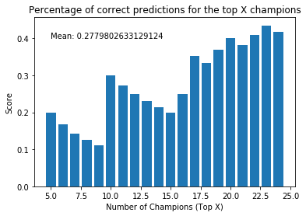
Evaluating the Recommender: Comparison to Real
Finally having determined the best recommender we pulled prediction scores from my personal account from a 3-fold cross validation. The results below show how the ranked predictions match up to the ranked real values with about 25% mean accuracy.

Slide 15
Final Thoughts
Producing actual recommendations will involve ignoring the prediction scores of the top 5-10 champions of the target user. The inaccuracy of the model for the top 10 results becomes less important because of this.
The client now has a full recommender pipeline which can be implemented to improve user engagement via champion suggestions.

Slide 16
Next Steps
Create API to implement a Web Application so anyone can try the recommender.
Implement Hybrid Collaborative/Content Filtering to create more accurate predictions for new champions. (Use champion stats such as difficulty)
Add in datasets for ranked information to create subsets of users at different skill levels. This should help account for the difference between competitive and casual players.

